Slide 1

CHAPTER 6 & 7
DESIGN CONCEPTS & architectural design
Department of Computer Science and Engineering
School of Engineering, Presidency University

Slide 2
Module 2: Software Requirements and Design (9 hrs.) – Comprehension level
Requirements Engineering: Eliciting requirements, Functional and non- Functional requirements, SRS, Requirements modelling: Developing Use Cases, Developing Activity diagram and Swim lane diagram, Design : Design concepts, Architectural design, Component based design, User interface design.
Dept. of CSE, SOE, Presidency University

Slide 3
Chapter 6 – Design Concepts
What is Design?
Analysis to Design transition
Quality Guidelines
Design Principles
Fundamental Design Concepts
  Abstraction
  Software Architecture
  Separation of Concerns
  Modularity
  Functional Independence – Cohesion and Coupling
  OO Design Concepts
  Design Model and Elements
Dept. of CSE, SOE, Presidency University

Slide 4
Chapter 7 – Architectural Design
What is Software Architecture
Importance of Software Architecture
Architectural Styles
  Data-centered Architectures
  Data Flow Architecture
  Call and Return Architecture
  Layered Architecture
Architectural Patterns
  Concurrency
  Persistence
  Distribution
Architecture Partitioning
Dept. of CSE, SOE, Presidency University

Slide 5
1. What is Design
Software design is the process by which an agent creates a specification of a software artifact, intended to accomplish goals, using a set of basic components and subject to constraints.
Good software design should exhibit:
  Firmness: A program should not have any bugs that inhibit its function.
  Commodity: A program should be suitable for the purposes for which it was intended.
  Delight: The experience of using the program should be pleasurable one.
Dept. of CSE, SOE, Presidency University

Slide 6
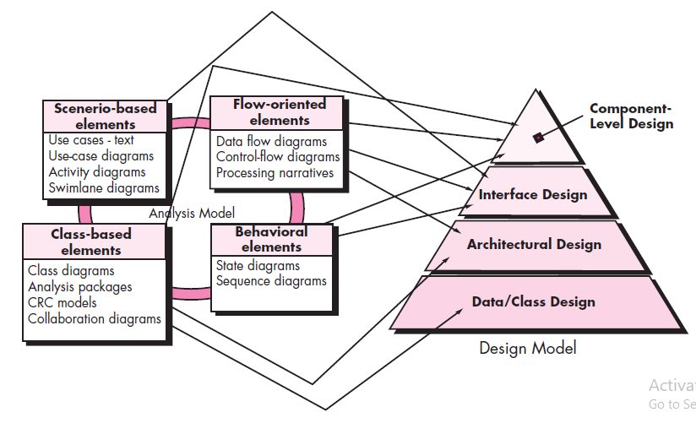
2. Analysis to Design Model Transition
Dept. of CSE, SOE, Presidency University

Slide 7
Design and Quality
Design must implement all of the explicit requirements contained in the analysis model, and it must accommodate all of the implicit requirements desired by the customer.
Design must be a readable, understandable guide for those who generate code and for those who test and subsequently support the software.
Design should provide a complete picture of the software, addressing the data, functional, and behavioral domains from an implementation perspective.
Dept. of CSE, SOE, Presidency University

Slide 8
3. Quality Guidelines
A design should exhibit an architecture that (1) has been created using recognizable architectural styles or patterns, (2) is composed of components that exhibit good design characteristics and (3) can be implemented in an evolutionary fashion
  For smaller systems, design can sometimes be developed linearly.
A design should be modular; that is, the software should be logically partitioned into elements or subsystems
A design should contain distinct representations of data, architecture, interfaces, and components.
A design should lead to data structures that are appropriate for the classes to be implemented and are drawn from recognizable data patterns.
Dept. of CSE, SOE, Presidency University

Slide 9
Quality Guidelines
A design should lead to components that exhibit independent functional characteristics.
A design should lead to interfaces that reduce the complexity of connections between components and with the external environment.
A design should be derived using a repeatable method that is driven by information obtained during software requirements analysis.
A design should be represented using a notation that effectively communicates its meaning.
Dept. of CSE, SOE, Presidency University

Slide 10
4. Design Principles
The design should be traceable to the analysis model.
The design should not reinvent the wheel.
The design should “minimize the intellectual distance” between the software and the problem as it exists in the real world.
The design should exhibit uniformity and integration.
The design should be structured to accommodate change.
The design should be structured to degrade gently, even when aberrant data, events, or operating conditions are encountered.
Design is not coding, coding is not design.
The design should be assessed for quality as it is being created, not after the fact.
The design should be reviewed to minimize conceptual (semantic) errors.
From Davis [DAV95]
Dept. of CSE, SOE, Presidency University

Slide 11
5. Fundamental Concepts
Abstraction - data, procedure, control
Architecture - the overall structure of the software
Separation of concerns - any complex problem can be more easily handled if it is subdivided into pieces
Modularity - compartmentalization of data and function
Functional independence - single-minded function and low coupling
Design Classes - provide design detail that will enable analysis classes to be implemented
Dept. of CSE, SOE, Presidency University

Slide 12
5.1 Data Abstraction
door
manufacturer
model number
type
swing direction
inserts
lights
type
number
weight
opening mechanism
implemented as a data structure
Dept. of CSE, SOE, Presidency University

Slide 13
Procedural Abstraction
open
details of enter
algorithm
implemented with a "knowledge" of the
object that is associated with enter
Dept. of CSE, SOE, Presidency University

Slide 14
5.2 Software Architecture
Software architecture refers to the high level structures of a software system and the discipline of creating such structures and systems.
Each structure comprises:
Software elements
Relations among the elements
Properties of both elements and relations
Dept. of CSE, SOE, Presidency University

Slide 15
5.3 Separation of Concerns
Any complex problem can be more easily handled if it is subdivided into pieces that can each be solved and/or optimized independently
A concern is a feature or behavior that is specified as part of the requirements model for the software
By separating concerns into smaller, and therefore more manageable pieces, a problem takes less effort and time to solve.
Dept. of CSE, SOE, Presidency University

Slide 16
5.4 Modularity
“Modularity is the single attribute of software that allows a program to be intellectually manageable”.
Monolithic software (i.e., a large program composed of a single module) cannot be easily grasped by a software engineer.
  The number of control paths, span of reference, number of variables, and overall complexity would make understanding close to impossible.
In almost all instances, you should break the design into many modules, hoping to make understanding easier and as a consequence, reduce the cost required to build the software.
Dept. of CSE, SOE, Presidency University

Slide 17
Modularity Trade-Offs
What is the "right" number of modules
for a specific software design?
module development cost
cost of
software
module
integration
cost
number of modules
Dept. of CSE, SOE, Presidency University

Slide 18
5.5 Functional Independence
Functional independence is achieved by developing modules with "single-minded" function and an "aversion" to excessive interaction with other modules.
Cohesion is an indication of the relative functional strength of a module.
  A cohesive module performs a single task, requiring little interaction with other components in other parts of a program. Stated simply, a cohesive module should (ideally) do just one thing.
Coupling is an indication of the relative interdependence among modules.
  Coupling depends on the interface complexity between modules, the point at which entry or reference is made to a module, and what data pass across the interface.
Dept. of CSE, SOE, Presidency University

Slide 19
5.6 OO Design Concepts
Design classes
  Entity classes
  Boundary classes
  Controller classes
Inheritance - all responsibilities of a superclass is immediately inherited by all subclasses
Messages - stimulate some behavior to occur in the receiving object
Polymorphism - a characteristic that greatly reduces the effort required to extend the design
Dept. of CSE, SOE, Presidency University

Slide 20
Design Classes
Analysis domain classes are refined during design to become entity classes
Boundary classes are developed during design to create the interface (e.g., interactive screen or printed reports) that the user sees and interacts with as the software is used.
  Boundary classes are designed with the responsibility of managing the way entity objects are represented to users.
Controller classes are designed to manage
  the creation or update of entity objects;
  the instantiation of boundary objects as they obtain information from entity objects;
  complex communication between sets of objects;
  validation of data communicated between objects or between the user and the application.
Dept. of CSE, SOE, Presidency University

Slide 21
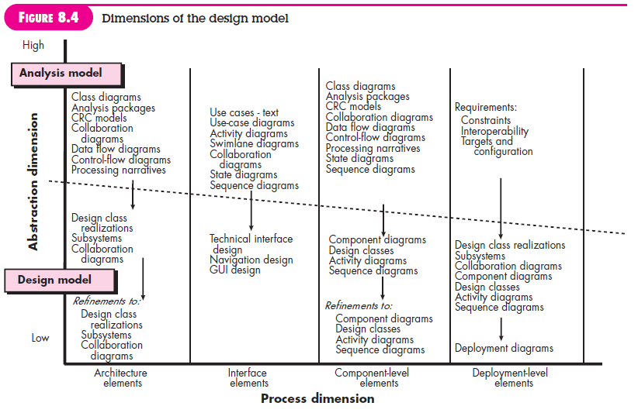
5.7 The Design Model
Dept. of CSE, SOE, Presidency University

Slide 22
Design Model Elements
Data elements
  Data model --> data structures
  Data model --> database architecture
Architectural elements
  Application domain
  Analysis classes, their relationships, collaborations and behaviors are transformed into design realizations
  Patterns and “styles”
Interface elements
  the user interface (UI)
  external interfaces to other systems, devices, networks or other producers or consumers of information
  internal interfaces between various design components.
Component elements
Deployment elements
Dept. of CSE, SOE, Presidency University

Slide 23
Architectural Design
1.1 Software Architecture
The software architecture of a program or computing system is the structure or structures of the system, which comprise software components, the externally visible properties of those components, and the relationships among them.
1.2 Importance of Software Architecture
Representations of software architecture are an enabler for communication between all parties (stakeholders) interested in the development of a computer-based system.
The architecture highlights early design decisions that will have a profound impact on all software engineering work that follows and, as important, on the ultimate success of the system as an operational entity.
Architecture “constitutes a relatively small, intellectually graspable mode of how the system is structured and how its components work together”
Dept. of CSE, SOE, Presidency University

Slide 24
1.3 Architectural Styles
An architectural style is a transformation that is imposed on the design of an entire system.
Each style describes a system category that encompasses:
(1) Set of components (e.g., a database, computational modules) that perform a function required by a system
(2) Set of connectors that enable “communication, coordination and cooperation” among components
(3) Constraints that define how components can be integrated to form the system, and
(4) Models that enable a designer to understand the overall properties of a system by analyzing the known properties of its constituent parts.
Dept. of CSE, SOE, Presidency University

Slide 25
Types of Architectural Styles
Data-centered architectures
Data flow architectures
Call and return architectures
Object-oriented architectures
Layered architectures
Dept. of CSE, SOE, Presidency University

Slide 26
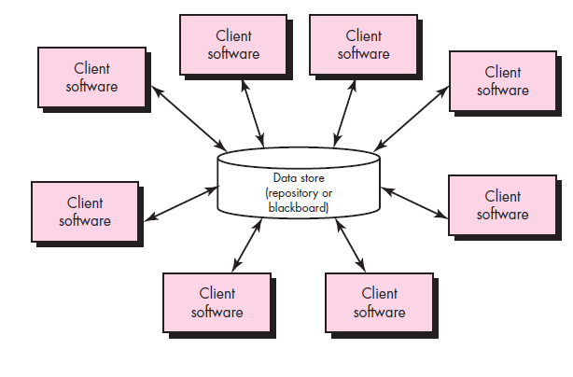
Data-Centered Architectures
Dept. of CSE, SOE, Presidency University

Slide 27
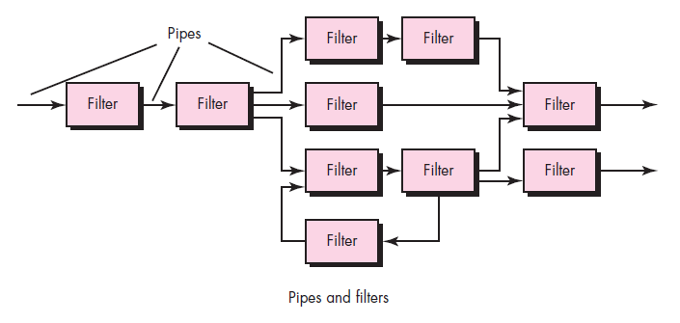
Data Flow Architectures
Dept. of CSE, SOE, Presidency University

Slide 28
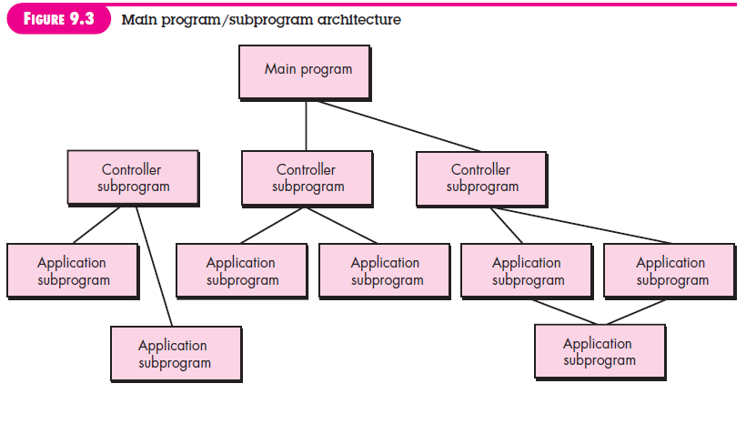
Call and Return Architectures
Dept. of CSE, SOE, Presidency University

Slide 29
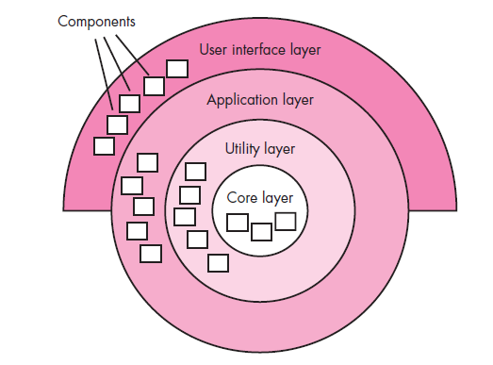
Layered Architectures
Dept. of CSE, SOE, Presidency University

Slide 30
4. Architectural Patterns
Architectural patterns address an application-specific problem within a specific context and under a set of limitations and constraints.
The pattern proposes an architectural solution that can serve as the basis for architectural design.
Dept. of CSE, SOE, Presidency University

Slide 31
Architectural Patterns
Concurrency - applications must handle multiple tasks in a manner that simulates parallelism
  operating system process management pattern
  task scheduler pattern
Persistence - Data persists if it survives past the execution of the process that created it. Two patterns are common:
  a database management system pattern that applies the storage and retrieval capability of a DBMS to the application architecture
  an application level persistence pattern that builds persistence features into the application architecture
Distribution - the manner in which systems or components within systems communicate with one another in a distributed environment
  A broker acts as a ‘middle-man’ between the client component and a server component.
Dept. of CSE, SOE, Presidency University

Slide 32
5. Partitioning the Architecture
Partitioning can be done “Horizontally” or “Vertically”
Dept. of CSE, SOE, Presidency University

Slide 33
Horizontal Partitioning
Define separate branches of the module hierarchy for each major function
Use control modules to coordinate communication between functions
function 1
function 3
Dept. of CSE, SOE, Presidency University

Slide 34
Vertical Partitioning
Design so that decision making and work are stratified
Decision making modules should reside at the top of the architecture
decision-makers
workers
Dept. of CSE, SOE, Presidency University

Slide 35
Why Data Partitioning
Results in software that is easier to test
Leads to software that is easier to maintain
Results in propagation of fewer side effects
Results in software that is easier to extend
Dept. of CSE, SOE, Presidency University

